Slide 1
Session 8
Introduction to JSON

Slide 2
Objectives
Define and describe JavaScript Object Notation (JSON)
Explain the uses of JSON
List and describe the features of JSON
Compare JSON with XML
Describe the advantages of JSON
Explain syntax and rules
Explain literal notation in JavaScript and conversion to JSON
Explain how to create a simple JSON file
<?xml>

Slide 3
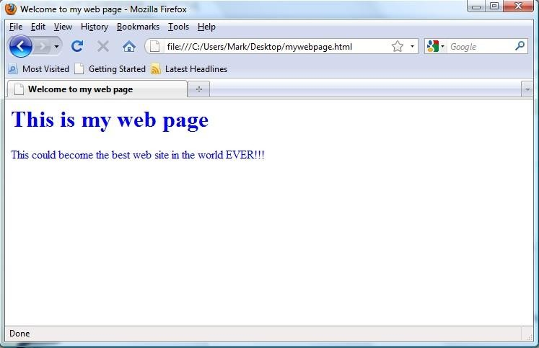
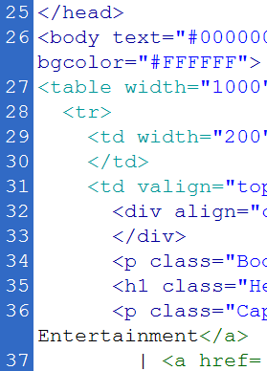
Introduction: The Need of JSON
XML parses using Document Object Model (DOM) with complex processes and no cross-browser compatibility.
JavaScript engine incorporates a markup language into an HTML Web page.
The need of more natural format native to this
engine and overcome DOM limitations was felt.
<?xml>

Slide 4

What is JSON
A lenient text format derived from JavaScript language and ECMAScript.
Platform-as well as language-independent.
Implements conventions of the C-based languages.
More concise than XML.
JSON is a lightweight, text-based, and open standard data-interchange format.
<?xml>
Notes:
Lenient: khoan hong

Slide 5
Uses of JSON
For serializing data to be sent over a network
For facilitating communication between incompatible platforms
For developing JavaScript based applications
For sending public data through Web services and
Application Programming Interfaces (APIs)
For fetching data without hard coding in HTML
<?xml>

Slide 6
History of JSON
Originally stated by Douglas Crockford
Coined initially at the State Software
Company
Coining the Term
To provide an abstraction layer for devising stateful Web applications without plugins
The Co-founders’ Decision
Implementing frames to send information to the browsers without refreshing the page
Participation by Other Companies
Implementing JavaScript as an object-based format for messaging
JSON.org in 2002
Crockford’s New Discovery
<?xml>
Notes:
Coining the Term: tao ta thuat ngu
Devise: dua ra, lap ra

Slide 7
Features of JSON 1-2
Standard structure
Simplicity
Open-source
Self-describing
Lightweight
Scalable/Reusable
<?xml>

Slide 8
Features of JSON 2-2
Clean data
Efficiency
Interoperability
Extensibility
Internationalization
<?xml>

Slide 9
JSON versus XML 1-3
Characteristic | JSON | XML
Data Types | Offers scalar data types. | Does not offer any idea of data types.
Array Support | Provides native support. | Expresses arrays by conventions.
Object Support | Provides native support. | Expresses objects by conventions.
Null Support | Recognizes the value natively. | Mandates the use of xsi:nil on elements.
Comments | Does not support. | Provides native support (via APIs).
<?xml>

Slide 10
JSON versus XML 2-3
Characteristic | JSON | XML
Namespaces | Does not support namespaces. | Accepts namespaces to prevent name collisions.
Formatting | Is simple and offers more direct data mapping. | Is complex and needs more effort for mapping application types to elements.
Size | Has very short syntax. | Has lengthy documents.
Parsing in JavaScript | Needs no additional application for parsing. | Implements XML DOM and requires extra code for mapping text to JavaScript objects.
Parsing | Has JSONPath. | Has XPath specification.
Learning Curve | Is not steep at all. | Is steep.
<?xml>

Slide 11
JSON versus XML 3-3
Characteristic | JSON | XML
Complexity | Is complex. | Is more complex.
Schema (Metadata) | Has a schema but is not widely used. | Uses many specifications for defining a schema.
Styling | Has no special specification. | Has XSLT specification for styling an XML document.
Querying | Has specifications such as JSON Query Language (JAQL) and JSONiq but are not widely used. | Has XQuery specification that is widely used.
Security | Is less secure, as the browser has no JSON parser. | Is more secure.
<?xml>

Slide 12


JSON versus XML Coding
JSON XML
{
<students>
<student>
<name>Steve</name>
<age>20</age>
<city>Denver</city>
</student>
<student>
<name>Bob</name>
<age>21</age> city>Sacramento</city>
</student>
"students":
[
{"name":"Steve",
"age":"20",
"city":"Denver"},
{"name":"Bob",
"age":"21",
"city":"Sacramento"}
]
}
<?xml>

Slide 13
Advantages of JSON
Quick serialization
Efficient encoding
Faster parsing than XML and Yaml Ain't Markup Language (YAML)
Simpler to work with other languages
Easy differentiation between data types
<?xml>

Slide 14
Limitations of JSON
Difficult in reading the format and precision of keeping brackets in its place
Following snippet illustrates complexity:
{
"problems": [{
"Diabetes":[{
"medications":[{ "medicationsClasses":[{ "className":[{
"associatedDrug":[{
"name":"Asprin", "dose":"", "strength":"500 mg“
}]
}]
}]
}]
}]
}]
}
<?xml>

Slide 15
JSON Data Structures
Support for two universally-supported data structures:
Ordered list of values, which can be an array, vector, list, or sequence.
Unordered set of name/value pairs, which can be
a keyed list, object, record, struct, or a hash table.
<?xml>

Slide 16

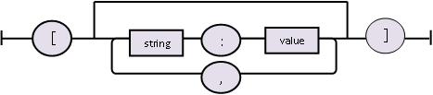
JSON Arrays and Objects
o Following figure represents an array (ordered set) in JSON:
o Following figure represents an object (unordered set) in JSON:
<?xml>

Slide 17
JSON Objects
o Following snippet represents a JSON object:
{
"Name":"Janet George", "Street":"123 Ashley Street", "City":"Chicago",
"Code":"60604"
}
<?xml>

Slide 18
JSON Syntax Rules
Arrays
Always in square brackets
Always in curly braces
Always in name value pairs separated by commas, with name and value delimited by colon
Objects
<?xml>

Slide 19
Literal Notation in JavaScript
Expresses fixed values literally.
Is a floating-point number, integer, string,
Boolean, array, or object.
Contains zero or more expressions in a sequence in an array literal.
Contains a list of members in an object literal.
<?xml>

Slide 20
JavaScript Array Literal Notation 1-2
o Following snippet defines an array using literal notation:
var fruits = ["Pineapple", "Orange", "Melon", "Kiwi", "Guava"];
alert (fruits[4] + " is one of the " + fruits.length + " fruits.");
<?xml>

Slide 21
JavaScript Array Literal Notation 2-2
o Following snippet defines an object using literal notation:
var Address = {
"Street": "123 New Mansion Street.", "City": "Denver",
"PostalCode": 80123 };
alert ("The product will be sent to postal code " + Address.PostalCode);
<?xml>

Slide 22

From JavaScript Literals to JSON
JSON has stricter rules:
Object member name to be a valid JSON string in quotation marks
A member value or an array element in JSON to be confined to a restricted set
JSON does not support Date/time literals.
<?xml>

Slide 23
Creating a JSON File
The JSON.stringify() function converts a JavaScript value to a serialized JSON string.
Following is the syntax:
JSON.stringify(value [, replacer] [,
space])
where,
value identifies a JavaScript value.
replacer represents a function or array.
space adds line break and white space.
<?xml>

Slide 24
Summary 1-2
JSON is a text-based and open standard format derived from JavaScript and ECMAScript.
JSON is lighter, more scalable, less complex, quicker to learn, and faster to process than XML.
JSON works independently of any language or platform.
JSON is preferred for serializing and de-
serializing data to be exchanged on the Web.
Data in JSON format is represented as name/value pairs.
<?xml>

Slide 25
Summary 2-2
JSON supports two data structures namely, array as ordered list and objects as unordered set of name/value pairs.
While syntax for JavaScript’s literal values is flexible, JSON follows stricter rules for arrays and objects.
A JSON file is saved with .json extension.
The JSON.stringify() function is used to
transform a JavaScript object to a JSON string.
<?xml>

